Slide 1
Learning the language of HTTp for better DATA experience
Chris Woodruff

Slide 2
AGENDA
How to Internet Works
What is HTTP
What parts of REST to know?
Summary

Slide 3
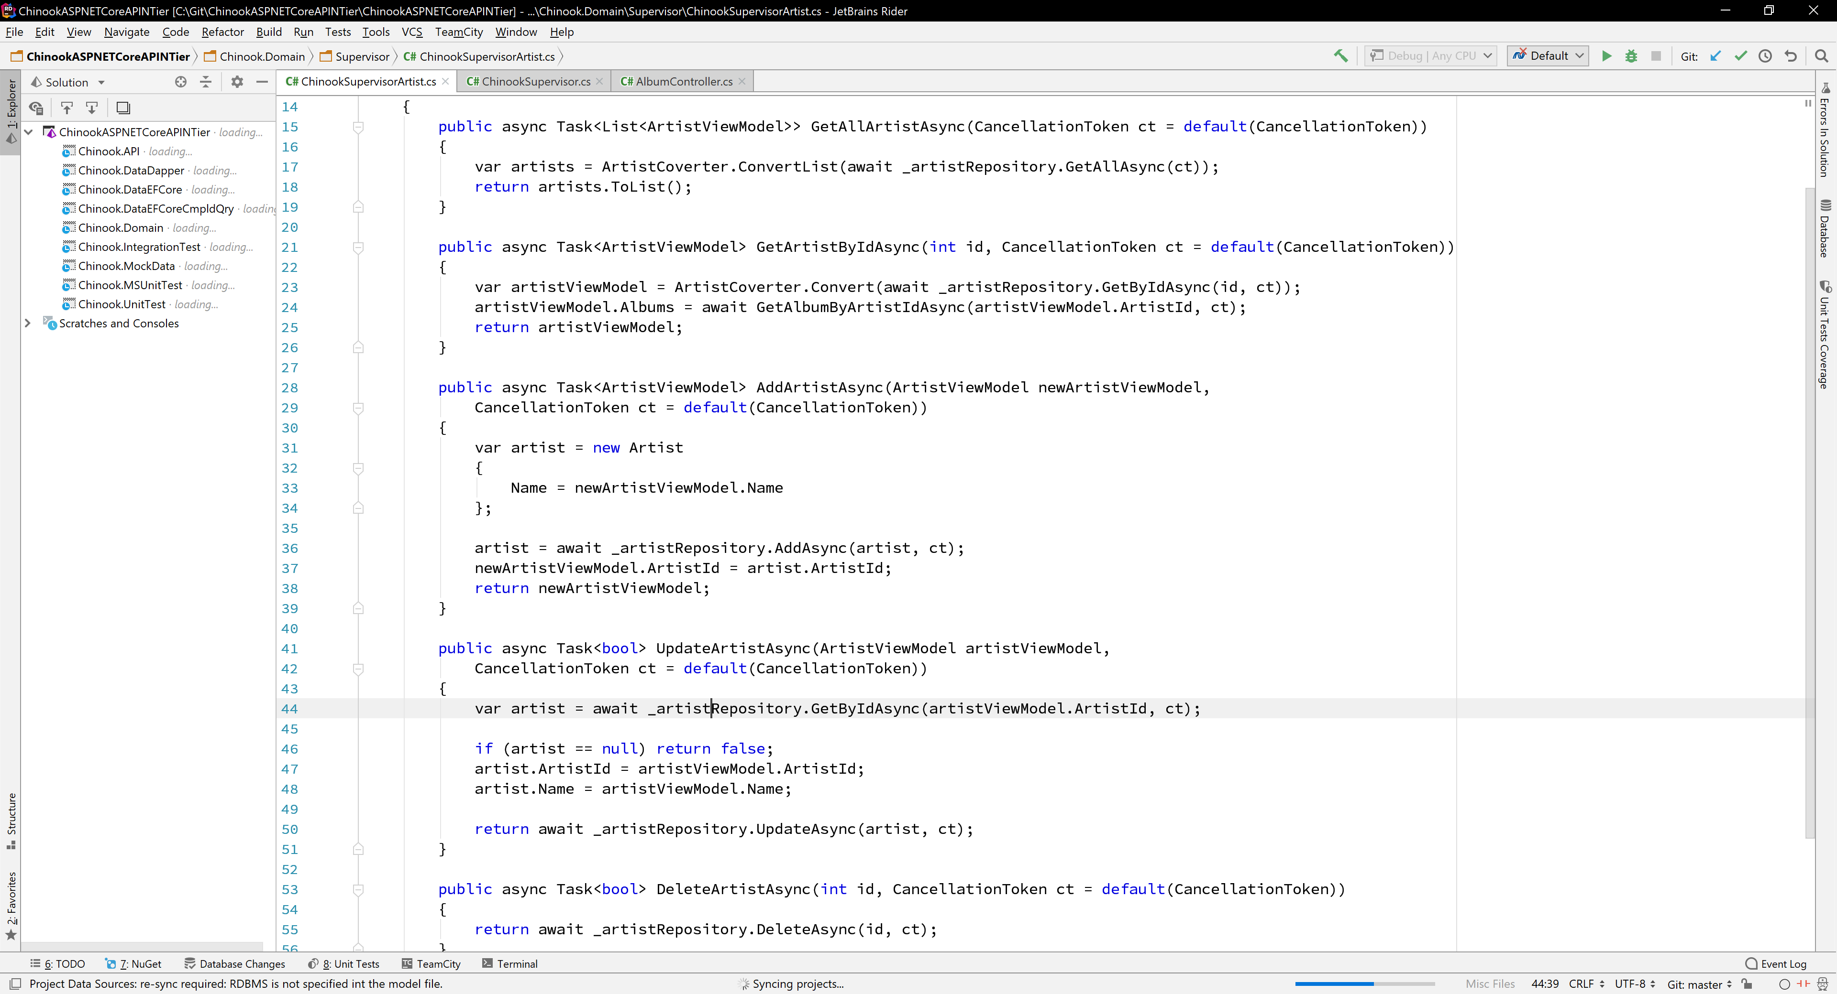


Slide 4
INTRODUCTION
Chris Woodruff
cwoodruff@live.com
Twitter – @cwoodruff

Slide 5
INTERNET
Let’s understand it

Slide 6
How the internet works
Client
Server
Initiates
Interaction
Responds to
Interaction

Slide 7
Types of Web Services
01
Remote Procedure Call (RPC)
02
Simple Object Access Protocol (SOAP)
Representational State Transfer (REST)
04
Calls over HTTP
03

Slide 8
HTTP
What do you have to know?

Slide 9
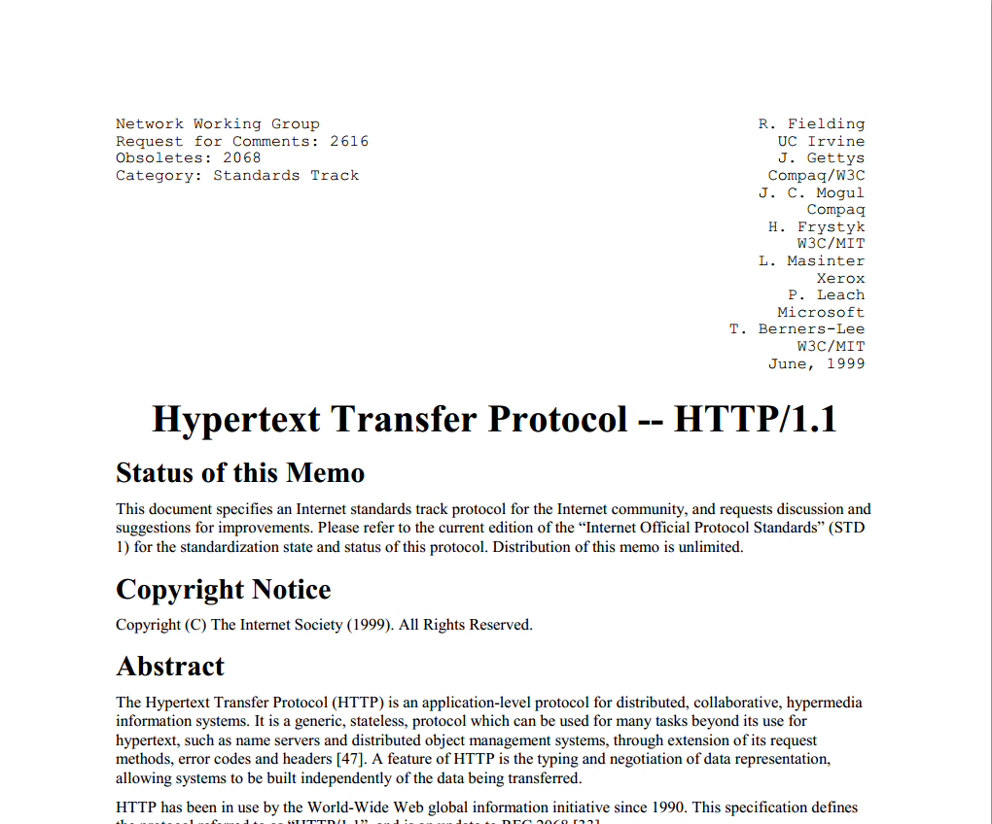

Slide 10
HTTP Methods or Verbs
GET
POST
PUT
DELETE
Queries the representation of a resource
Produces a new resource with given state
Changes the state of a resource (full)
Changes the state of a resource (partial)
Deletes resource
PATCH
SELECT
INSERT
UPDATE
UPDATE
DELETE

Slide 11
important HTTP Headers
Authorization
Content-Type
Accept
Cache-Control
Access-Control-Allow-Origin
client-side header
client and server-side header
client-side header
server-side header
server-side header

Slide 12
important HTTP Headers
Content-length
Expires
Content-language
Cookie
server-side header
server-side header
client-side header
server-side header

Slide 13
HTTP Response Codes
1XX
2XX
3XX
4XX
5XX
Information responses
Successful responses
Redirection messages
Client error responses
Server error responses

Slide 14
Common Response Codes
200
202
204
201
300
301
304
303
400
401
405
429
406
404
403
500
503
501
Notes:
200 OK
201 Created
202 Accepted
204 No Content
301 Moved Permanently
304 Not Modified
307 Temporary Redirect
308 Permanent Redirect
400 Bad Request
401 Unauthorized
403 Forbidden
404 Not Found
405 Method Not Allowed
407 Proxy Authentication Required
500 Internal Server Error
501 Not Implemented
503 Service Unavailable
504 Gateway Timeout

Slide 15
REST
What do you have to know?

Slide 16
Representational State Transfer
Client
Server
GET Request
Response
Resource

Slide 17



WHAT IS REST?
RESOURCES
URL
VERBS

Slide 18
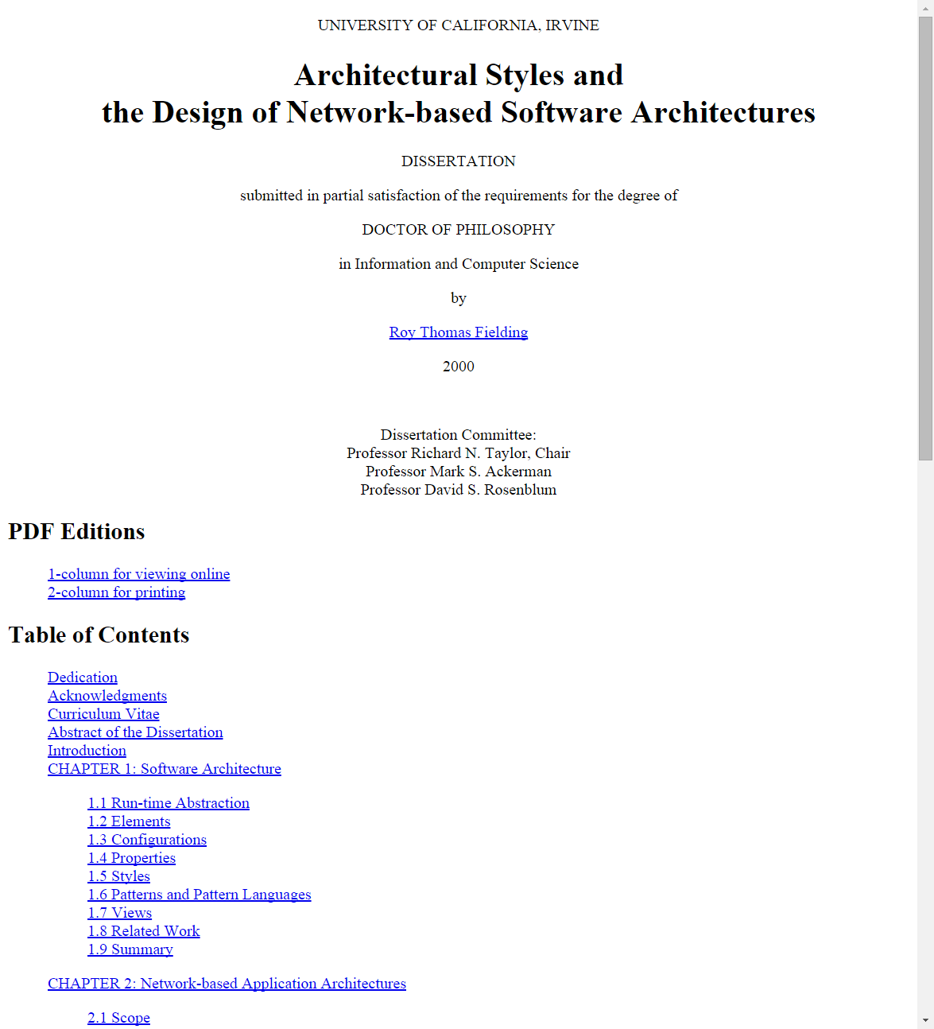

Slide 19
2 common perspectives on architectural design
Designer starts with nothing (blank) and builds an architecture from custom components
Designer starts with the system and applies constraints to elements of the system
REST!!!!

Slide 20
Constraints of REST
- Layered system style helps reduce complexity and promote independence. Layers can be used to protect new services from legacy clients. They can also add overhead.
Client-server Architecture
This separation allows for the two components to evolve independently, which increases scalability.
Stateless Communication
Each request from the client must contain all necessary information to understand the request.
Caching
- Eliminate some interactions and improve efficiency and scalability. Cache can decrease reliability because of stale data.
- Identification of Resources
Layered System
Uniform Interface
Code on Demand
- Manipulation of Resources through Representations
- Self-descriptive Messages
- HATEOAS
Client functionality to be extended by downloading and executing code in the form of scripts
- Architecture to be composed of hierarchical layers
- Require that the data within a response to a request be labeled as cacheable or non-cacheable.

Slide 21
GET VERB
200
304
405
406
401
410
429
451
500
503
OK
Not Modified
Resource has not changed since last request
Unauthorized
Method not Found
Not Acceptable
Server does not have the content type requested
Gone
Too Many Request
Rate Limiting
Unavailable for Legal Reasons
Server Error
Service Unavailable
Request can be retired
Resource is not here any longer

Slide 22
POST VERB
201
400
401
405
415
429
451
500
503
Created
Bad Request
Unauthorized
Method Not Allowed
Unsupported Media Type
Too Many Requests
Unavailable for Legal Reasons
Server Error
Service Unavailable
Request can be retired
Validation Error
Server doesn’t support that content type
Rate limiting
204
No Content

Slide 23
PUT VERB
200
204
400
401
404
405
409
412
415
429
451
500
503
OK
No Content
Bad Request
Validation error
Unauthorized
Not Found
Method not allowed
Conflict
Cannot update resource due to state
Precondition Failed
Resource state has changed since last request
Unsupported Media Type
Server does not support the content type
Too Many Requests
Rate limiting
Unavailable for Legal Reasons
Server Error
Service Unavailable
Request can be retired

Slide 24
DELETE VERB
204
401
404
405
412
409
429
451
500
503
No Content
Unauthorized
Not Found
Method Not Allowed
Precondition Failed
Resource state has changed since last request
Conflict
Cannot delete resource due to state
Too Many Requests
Rate limiting
Unavailable For Legal Reasons
Server Error
Service Unavailable
Request can be retired

Slide 25
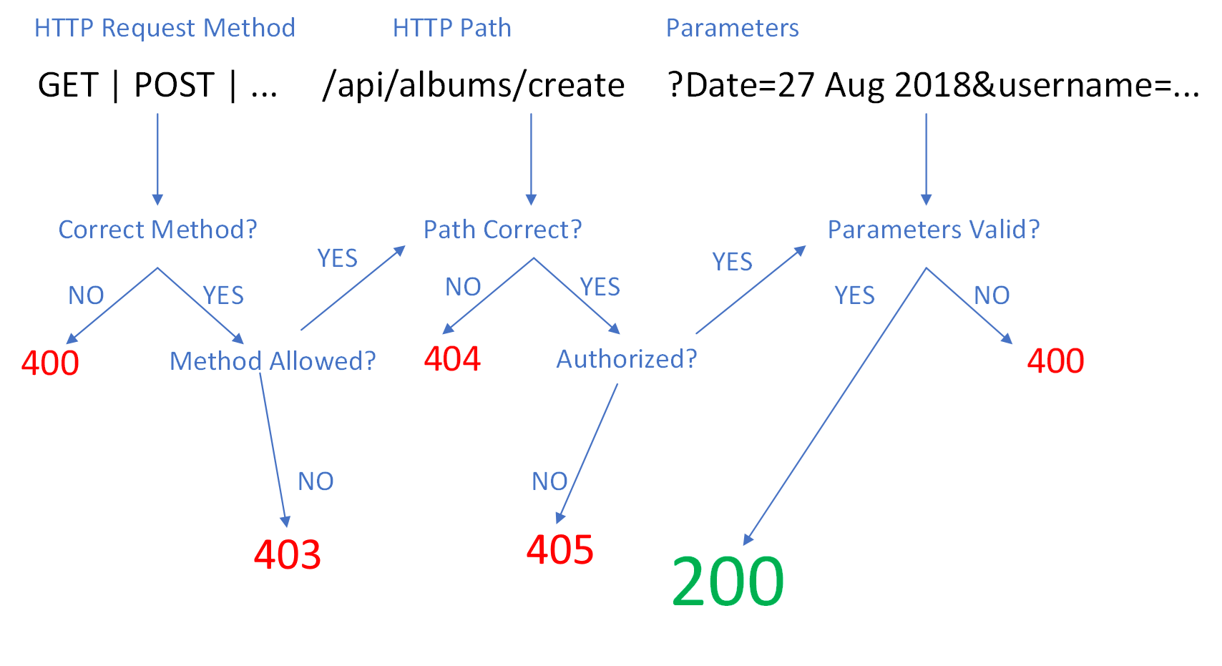
Workflow for an HTTP REST Request

Slide 26
REST Quiz
RESOURCE
VERB
EXPECTED OUTCOME
RESPONSE CODE
/Products
GET
A list of all products in the system
200 OK
/Products?Color=green
GET
A list of all products in the system where the color is green
200 OK
/Products
POST
Creation of a new product
201 Created
/Products/81
GET
Product with an ID of 81
200 OK
/Products/881
GET
No product with ID 881
404 Not Found
/Products/81
PUT
Update of the product with ID of 81
204 No Content
/Products/81
PUT
Update of the product with ID of 81
412 Precondition Failed
/Products/81
DELETE
Deletion of the product with ID of 81
204 No Content

Slide 27
What to remember for better apis
Understand HTTP
Learn how to use HTTP Verbs
Understand rest
Learn how to use Response Codesrstand REST

Slide 28
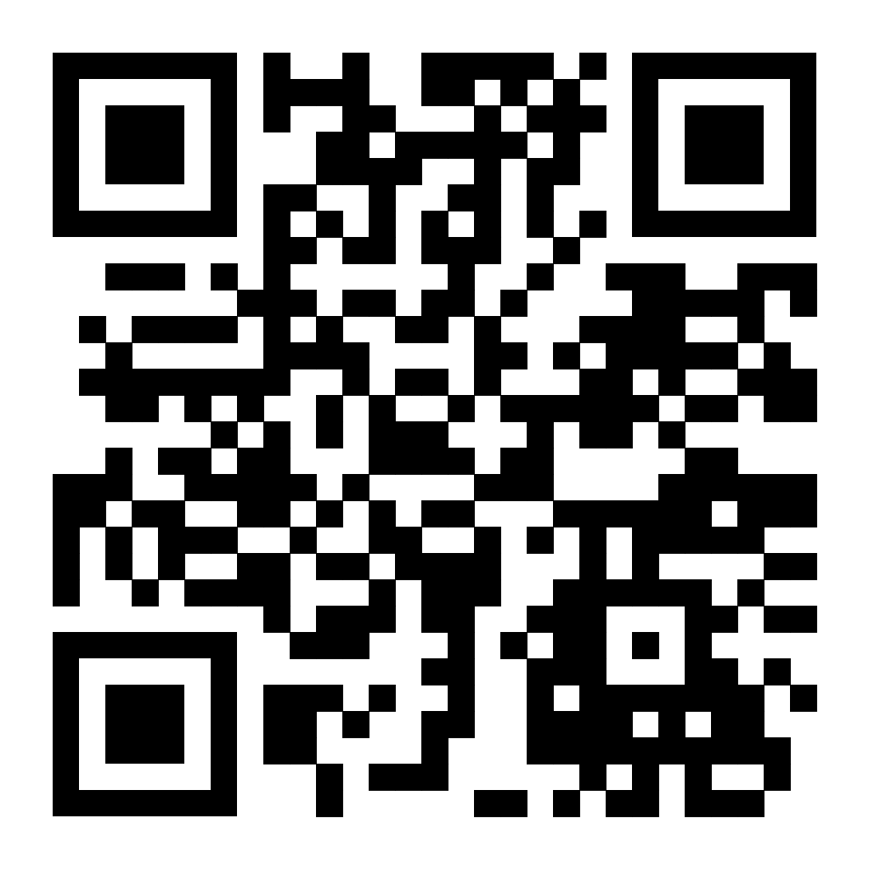
THANK YOU
Chris Woodruff
cwoodruff@live.com
Twitter – @cwoodruff
https://github.com/cwoodruff/LanguageOfHTTP

